Slide 1

Neural Networks Introduction @DETERMINED 2022 Workshop
Dr. U. Michelucci (TOELT)

Slide 2
Idea of NN
Advantages and disadvantages (black-box, explainability is difficult, etc.) of NN
Comparison biological neuron and artificial neuron
Composition of multiple simple units

Slide 3
Learning goals
The student can explain what is a neural network
The student understand what it means to “learn” for a neural network
The student can list the three most important components of a neural network
The student understand the main components of a neuron
The student understand how to frame a classification problem with neural networks
The student understand how gradient descent work in 1-dimension and what challenges exist for neural networks

Slide 4
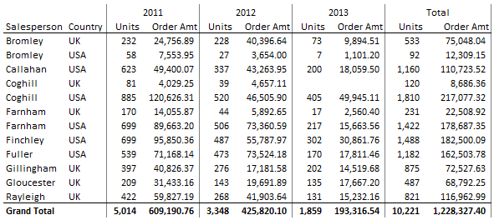
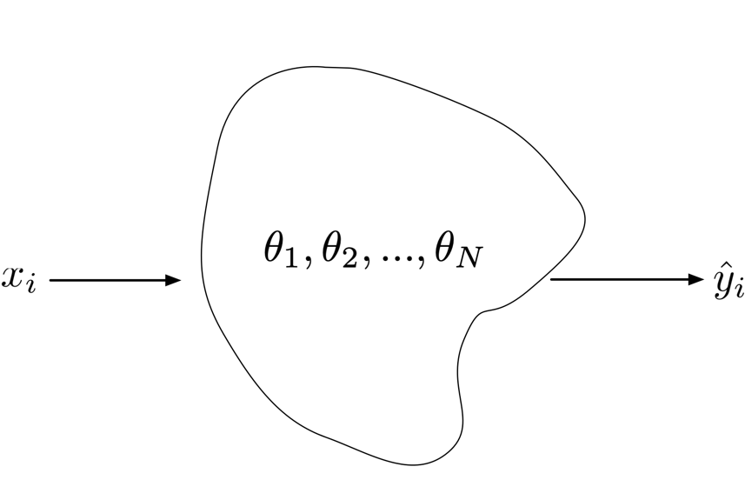
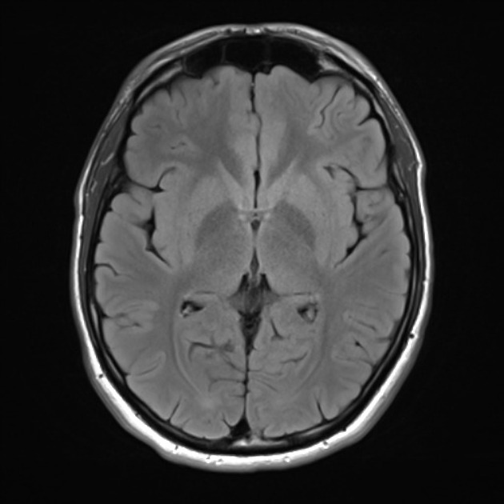
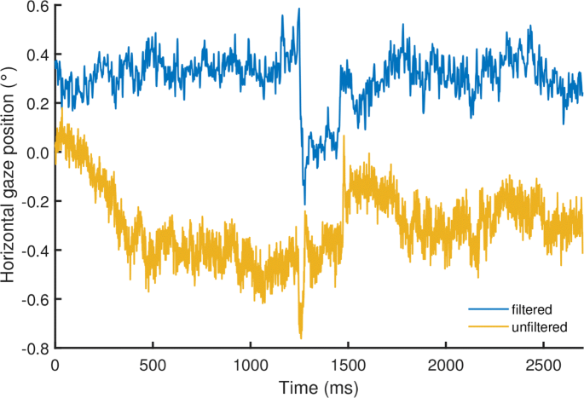
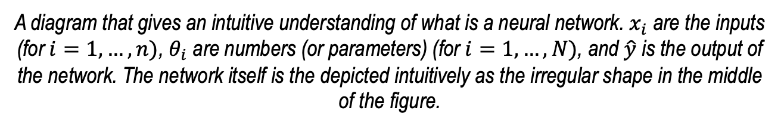
An intuitive understanding of a neural network
Class 1,
Class 2,
Class 3,
Etc.
Outputs
1.73
Inputs
A diagram that gives an intuitive understanding of what is a neural network. $x_{i}$ are the inputs (for $i=1,…,n)$, $θ_{i}$ are numbers (or parameters) (for $i=1,…,N)$, and $\hat{y}$ is the output of the network. The network itself is the depicted intuitively as the irregular shape in the middle of the figure.

Slide 5
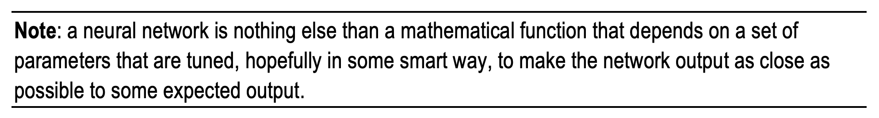
An intuitive definition of learning
What does it mean “as close as possible”?
We need a mathematical way of measuring “closeness”
U. Michelucci, Applied Deep Learning with TensorFlow 2, Springer Nature, 2022

Slide 6
An intuitive definition of learning
Loss Function
Optimiser
Neural Network Architecture
U. Michelucci, Applied Deep Learning with TensorFlow 2, Springer Nature, 2022

Slide 7
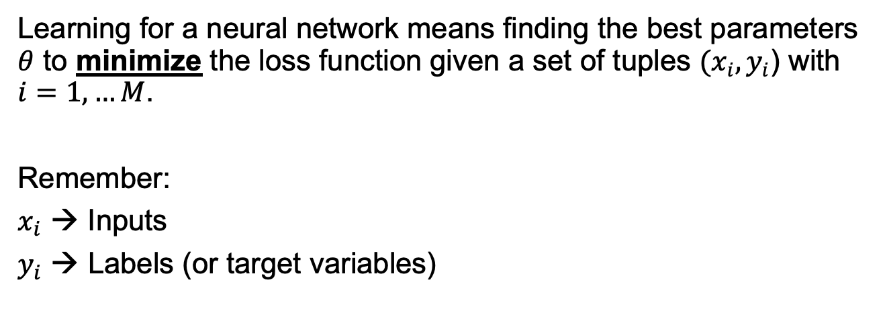
Learning in the context of neural networks
Learning for a neural network means finding the best parameters $θ$ to minimize the loss function given a set of tuples $(x_{i}, y_{i}$) with $i=1,…M$.
Remember:
$x_{i}$ → Inputs
$y_{i}$ → Labels (or target variables)
A mathematical formula
to measure “closeness”

Slide 8
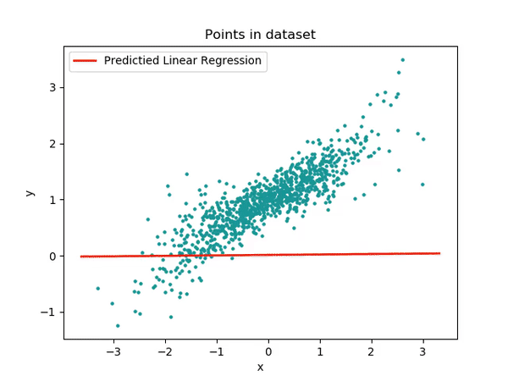
Example of learning
Image © Towarddatascience

Slide 9
The 3 main components of a neural network model
The neural network architecture (type of network, number of layers, etc.)
The loss function (the one we want to minimise)
The optimiser (the algorithm to find the minimum of the loss function)

Slide 10
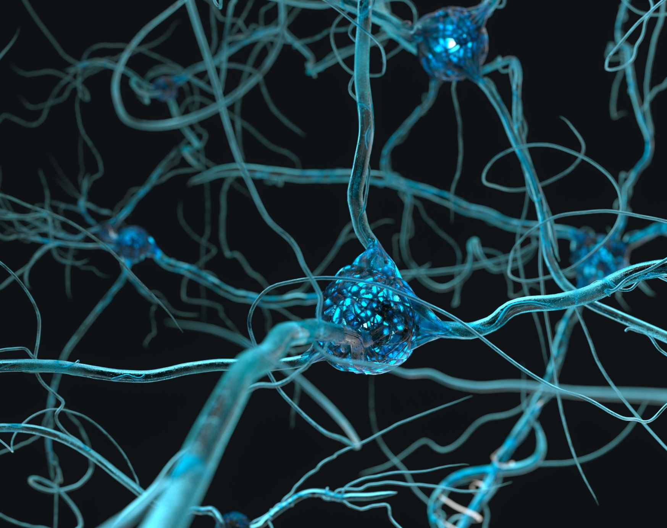
Structure of a neuron

Slide 11
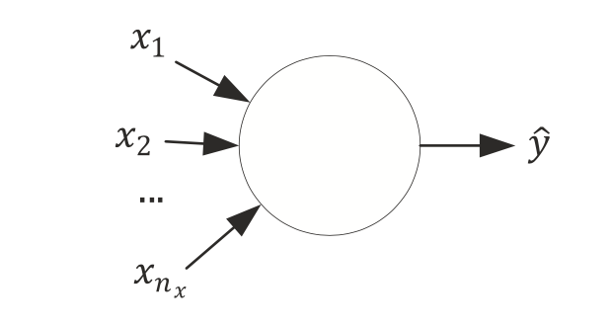
A neuron without details

Slide 12
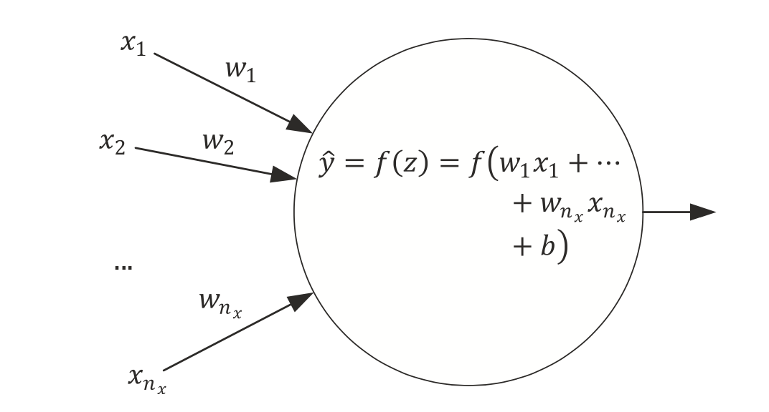
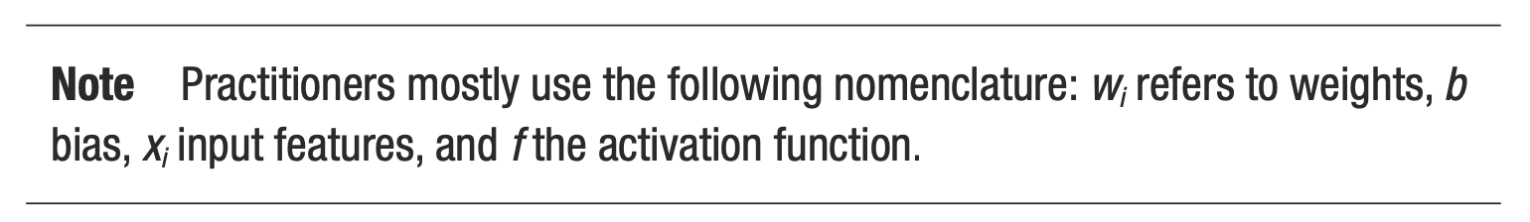
Simplest network possible
The simplest neural network that we can create is made of one single neuron.
Source:Umberto Michelucci, Applied Deep Learning - A Case-Based Approach to Understanding Deep Neural Networks, APRESS 2018

Slide 13
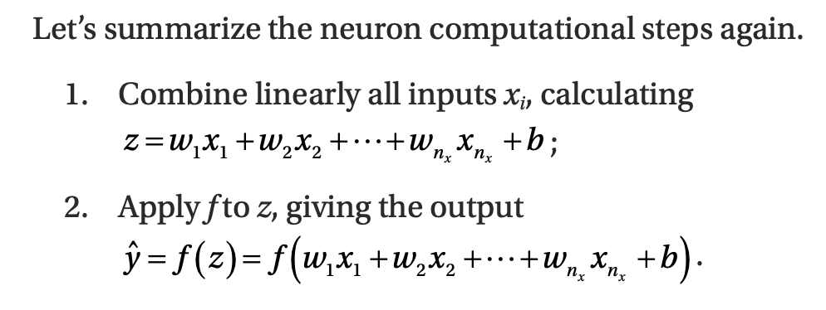
Computational Steps of a single neuron
Weights
Bias
Activation Function
Source:Umberto Michelucci, Applied Deep Learning - A Case-Based Approach to Understanding Deep Neural Networks, APRESS 2018

Slide 14
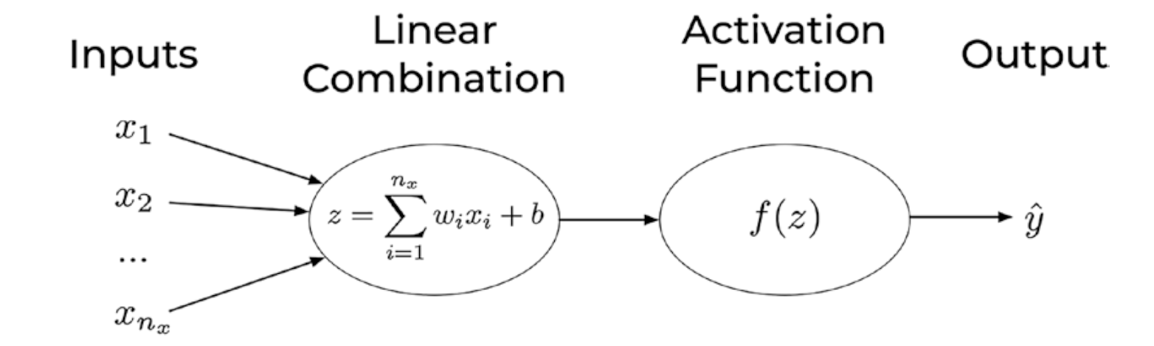
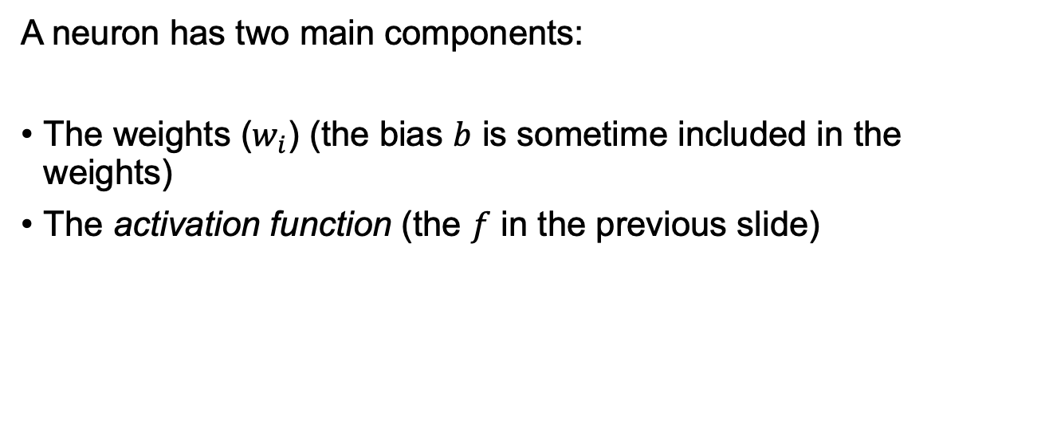
Components of a neuron
A neuron has two main components:
The weights ($w_{i}$) (the bias $b$ is sometime included in the weights)
The activation function (the $f$ in the previous slide)
U. Michelucci, Applied Deep Learning with TensorFlow 2, Springer Nature, 2022

Slide 15
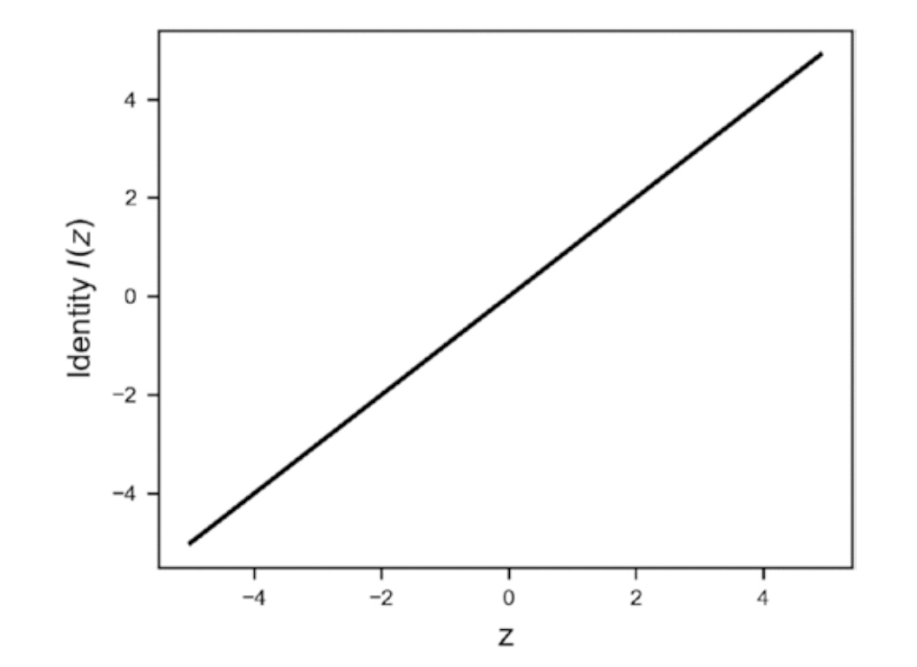
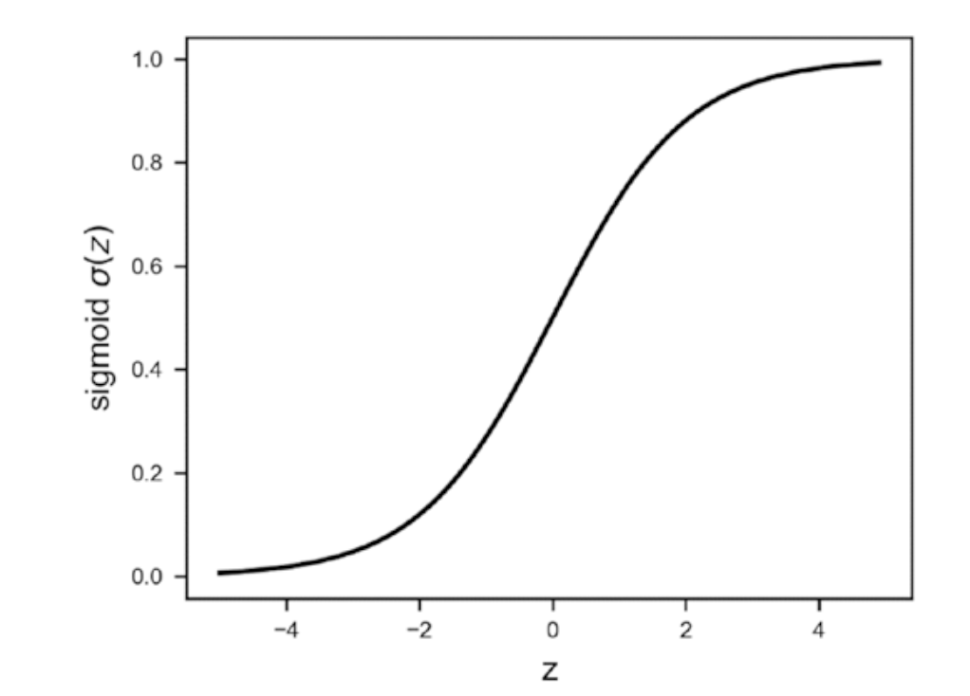
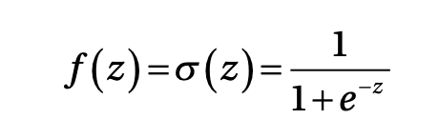
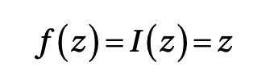
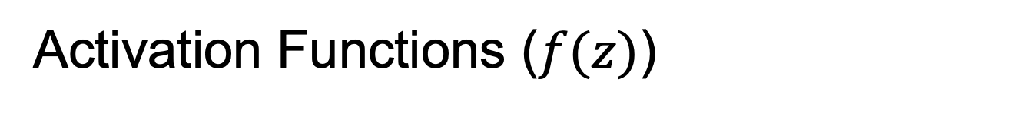
Activation Functions ($f(z)$)
Identity
Sigmoid

Slide 16
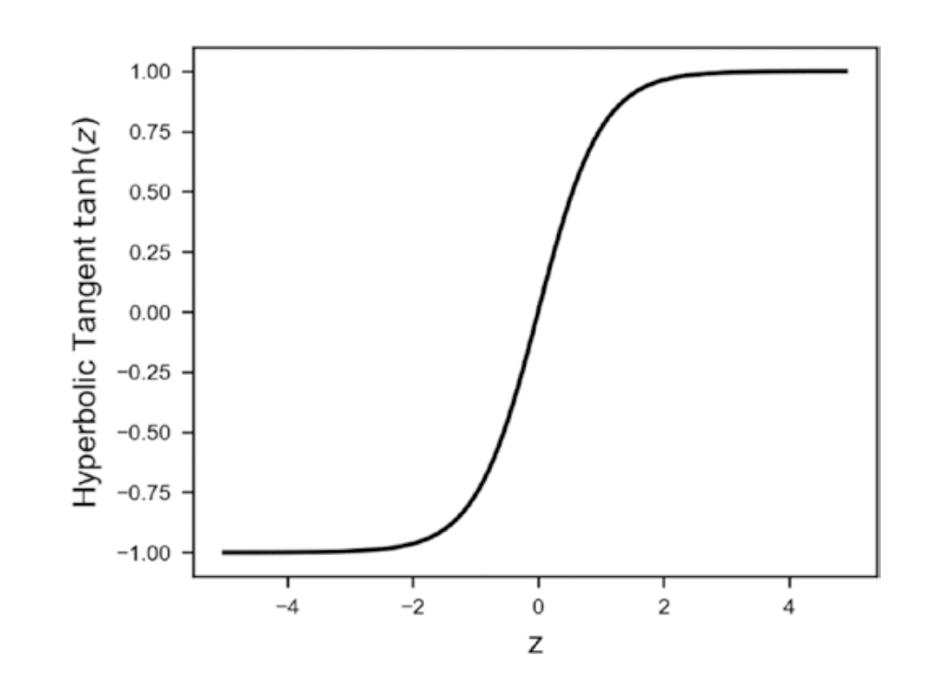
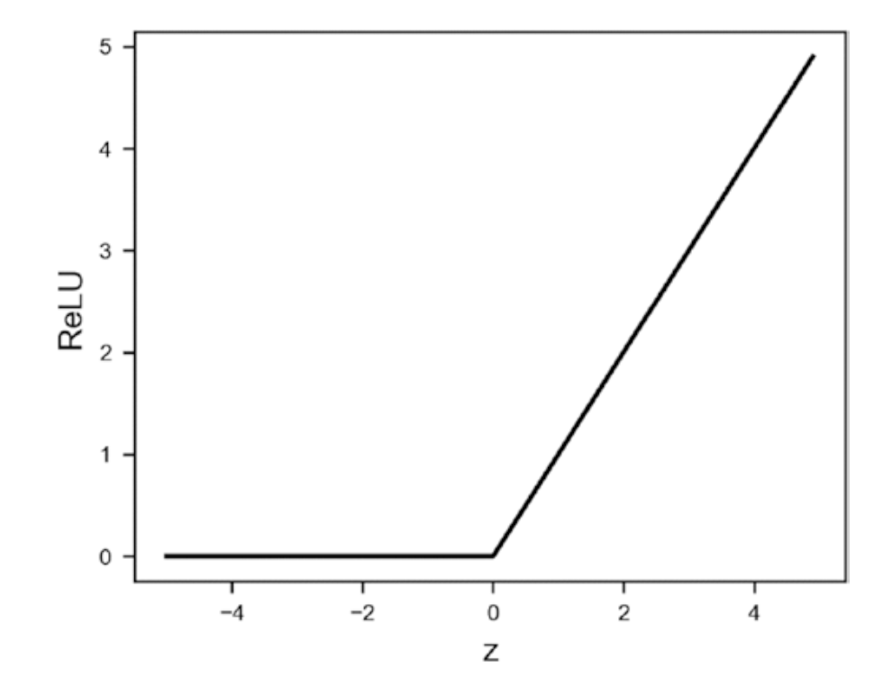
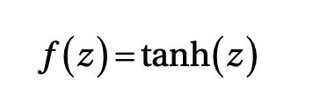
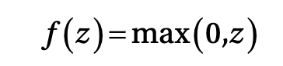
Activation Functions ($f(z)$)
Hyperbolic Tangent
ReLU (Rectified Linear Unit)

Slide 17
Activation Functions ($f(z)$)
Many others:
Leaky ReLU
Swish
ArcTan
Exponential Linear Unit (ELU)
Softplus

Slide 18
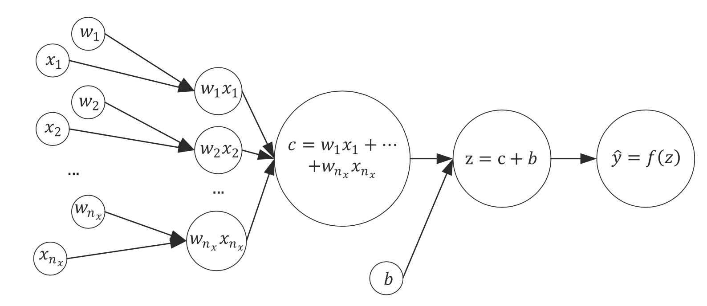
The same network seen as a computational graph
A computational graph is a directed graph where the nodes correspond to operations or variables. Variables can feed their value into operations, and operations can feed their output into other operations. This way, every node in the graph defines a function of the variables. (From: http://www.deepideas.net/deep-learning-from-scratch-i-computational-graphs/)
Source:Umberto Michelucci, Applied Deep Learning - A Case-Based Approach to Understanding Deep Neural Networks, APRESS 2018

Slide 19
What is a tensor (why TensorFlow?)
In its simplest (and somehow incorrect) definition a Tensor is simply a multi-dimensional array of numbers.
An image is a tensor of 3-dimensions (the horizontal and vertical resolution and the colors, RGB).

Slide 20
Learning for a neuron includes 3 components
A neural network (defined by its architecture, in other words the computational steps to evaluate the network output)
A loss function (a function to measure how good or bad the network is predicting the outputs)
An algorithm to minimize the loss function (also called optimizer)
Source:Umberto Michelucci, Applied Deep Learning - A Case-Based Approach to Understanding Deep Neural Networks, APRESS 2018

Slide 21
Quiz: What can a neuron do?
We have discussed how a neuron looks like. But how can a neuron solve any type of problem?
Can a neuron solve a classification and a regression problem? How can we do that?
Question to you: which component of a neuron is responsible for the type of problem we want to solve?
Notes:
Draw on the blackboard all the components of a neuron and the 3 components of a model and ask students which part is relevant

Slide 22
Which portion of a neural network model is responsible for the type of problem that can be solved?
Two main components are responsible for the type of problem that can be solved:
The output activation function
The loss function
→ The optimiser is not related in any way to the type of problem solved.

Slide 23
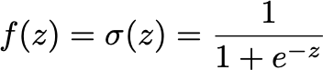
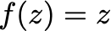
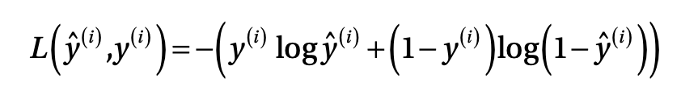
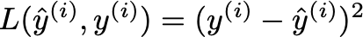
A single neuron can do a lot
Logistic regression (binary classification)
Linear regression

Slide 24
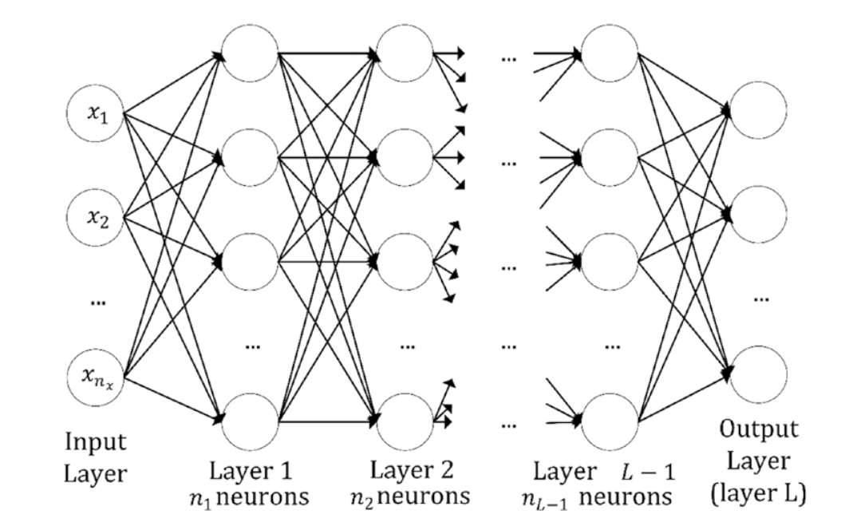
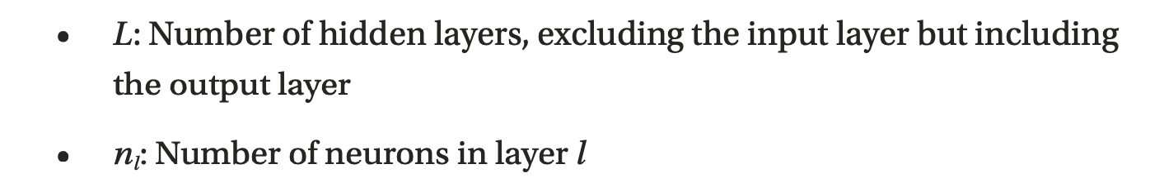
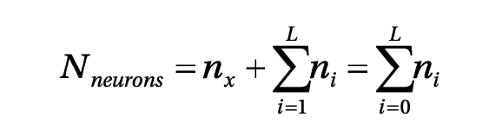
Multiple neurons / multiple layers
Layer (no intra-layer connection)
Quiz: Do you think there is any rule or best practice in deciding how many neurons/layers you should use?
Source:Umberto Michelucci, Applied Deep Learning - A Case-Based Approach to Understanding Deep Neural Networks, APRESS 2018

Slide 25
How to do classification if the output is a real number?

Slide 26
Classification Problem and output activation function The Softmax function

Slide 27
Neural Network Architecture (example with 3 classes)
How should we interpret those numbers?
We would like to interpret them as the probability of the input observation to be in class 1, 2 or 3.
Network
Input

Slide 28
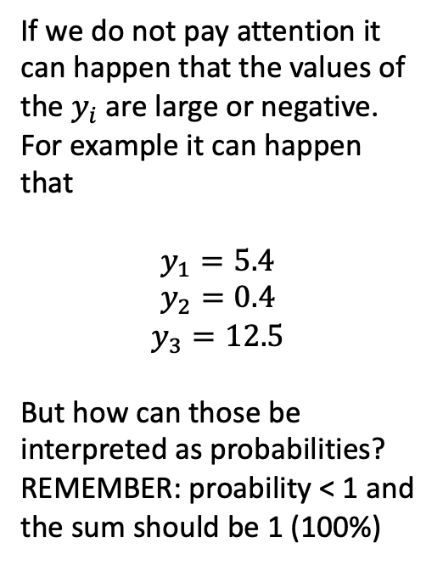
Neural Network Architecture (example with 3 classes)
If we do not pay attention it can happen that the values of the $y_{i}$ are large or negative. For example it can happen that
$$y_{1}=5.4$$
$$y_{2}=0.4$$
$$y_{3}=12.5$$
But how can those be interpreted as probabilities? REMEMBER: proability < 1 and the sum should be 1 (100%)
Network
Input

Slide 29
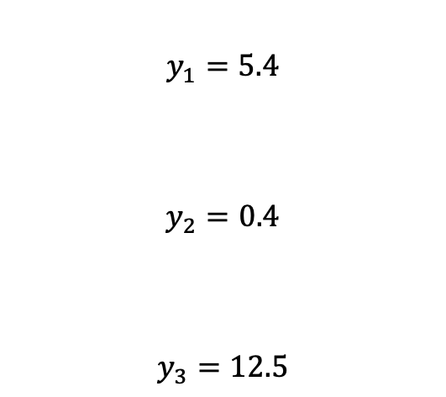
Neural Network Architecture (example with 3 classes)
$$y_{1}=5.4$$
$$y_{2}=0.4$$
$$y_{3}=12.5$$
Network
Input

Slide 30
Neural Network Architecture (example with 3 classes)
Network
Function
Input

Slide 31
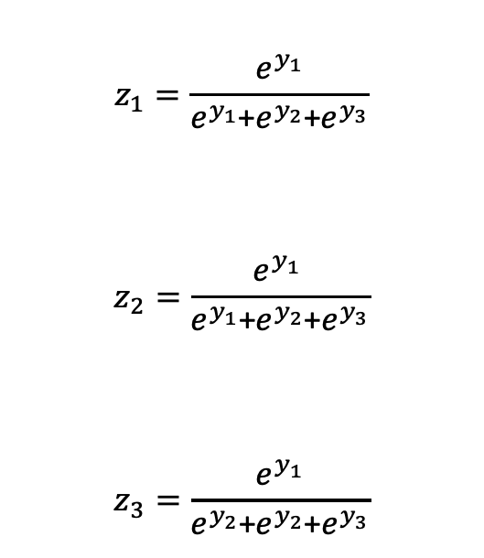
Neural Network Architecture (example with 3 classes)
$$z_{1}=\frac{e^{y_{1}}}{e^{y_{1}}\text{+}e^{y_{2}}\text{+}e^{y_{3}}}$$
$$z_{2}=\frac{e^{y_{1} }}{e^{y_{1}}\text{+}e^{y_{2}}\text{+}e^{y_{3}}}$$
$$z_{3}=\frac{e^{y_{1}}}{e^{y_{2}}\text{+}e^{y_{2}}\text{+}e^{y_{3}}}$$
Function

Slide 32
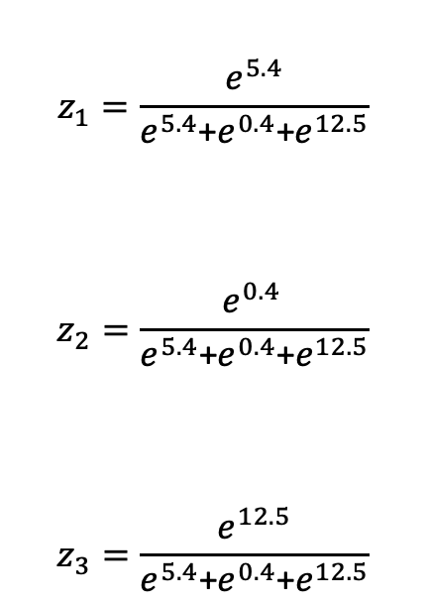
Neural Network Architecture (example with 3 classes)
$$z_{1}=\frac{e^{5.4}}{e^{5.4}\text{+}e^{0.4}\text{+}e^{12.5}}$$
$$z_{2}=\frac{e^{0.4 }}{e^{5.4}\text{+}e^{0.4}\text{+}e^{12.5}}$$
$$z_{3}=\frac{e^{12.5}}{e^{5.4}\text{+}e^{0.4}\text{+}e^{12.5}}$$
Function

Slide 33
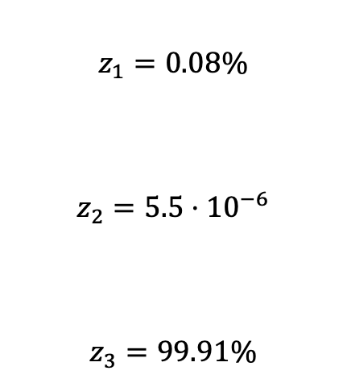
Neural Network Architecture (example with 3 classes)
$$z_{1}=0.08\%$$
$$z_{2}=5.5⋅{10}^{−6}$$
$$z_{3}=99.91\%$$
Function

Slide 34
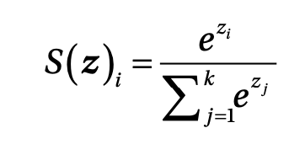
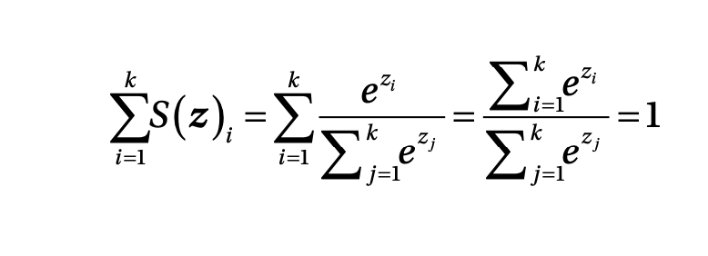
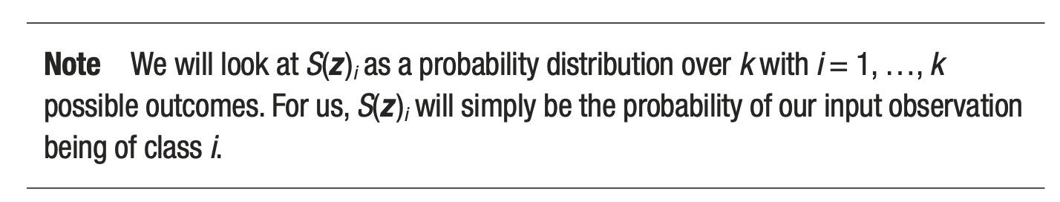
Softmax output layer for classification
Output of ith neuron of the output layer
Note that they can be interpreted as probability since the sum is equal to 1
Source:Umberto Michelucci, Applied Deep Learning - A Case-Based Approach to Understanding Deep Neural Networks, APRESS 2018

Slide 35
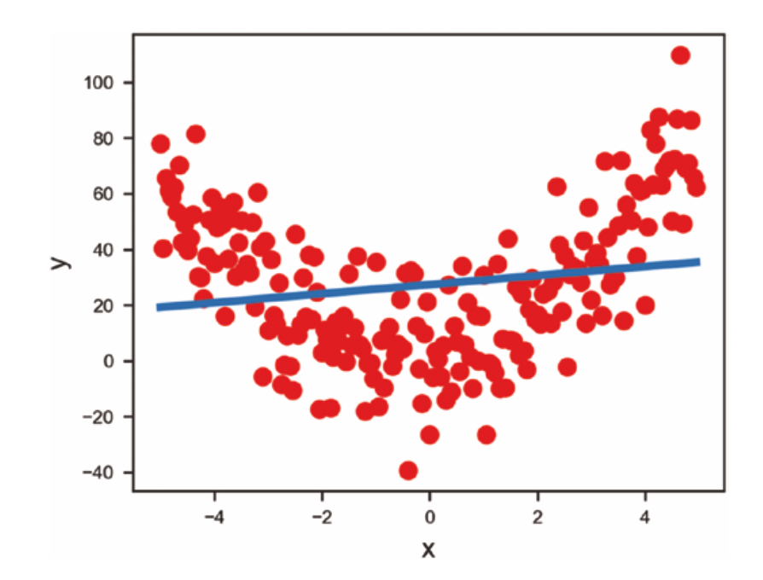
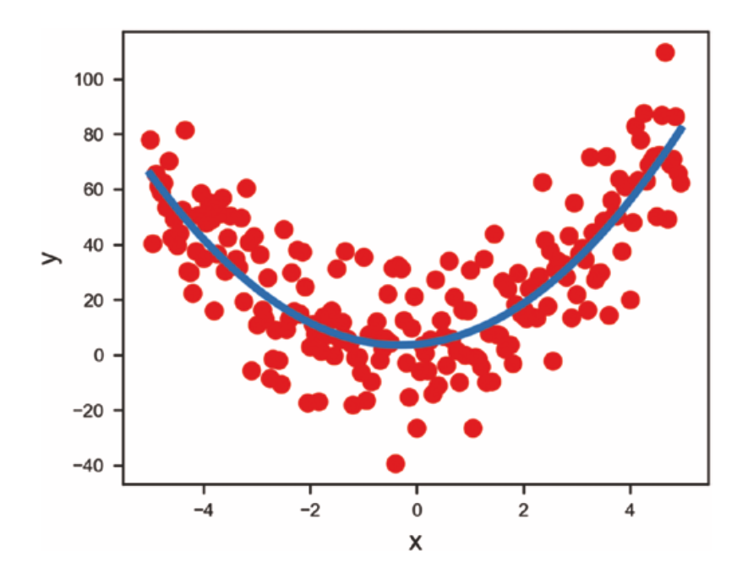
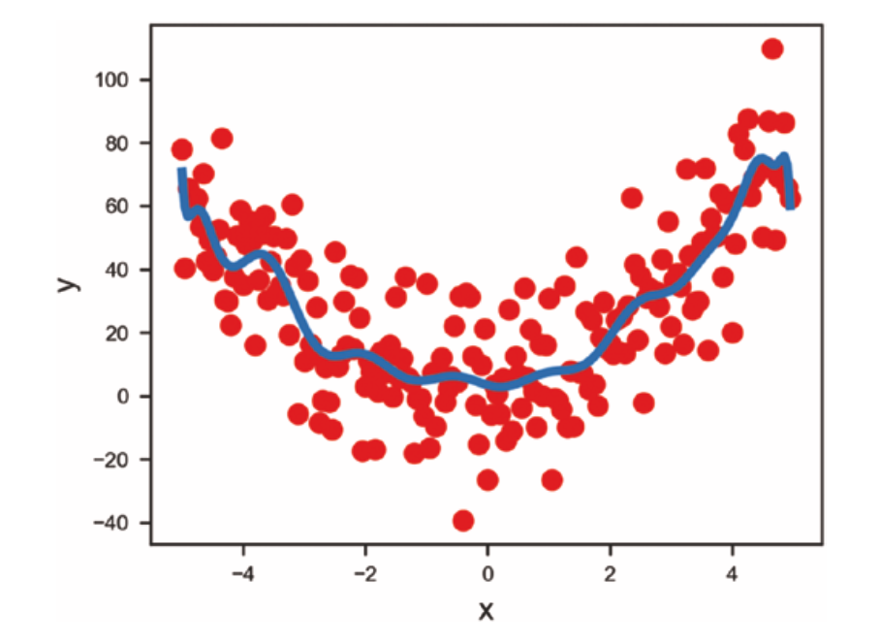
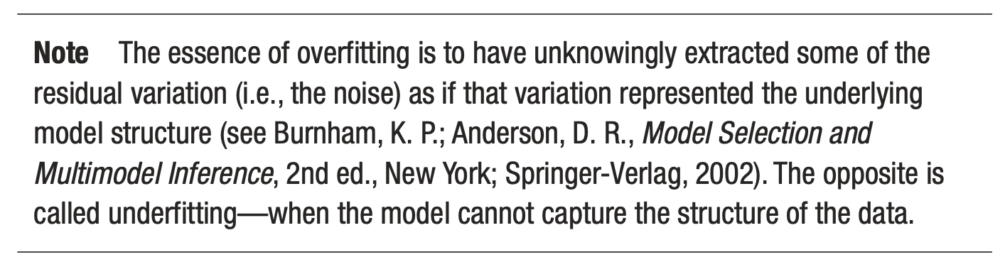
First problem - overfitting
Source:Umberto Michelucci, Applied Deep Learning - A Case-Based Approach to Understanding Deep Neural Networks, APRESS 2018
Underfitting
Just fitting ;-)
Overfitting

Slide 36
Optimizers

Slide 37
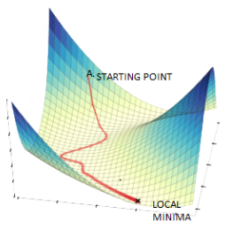
Gradient Descent
Image source: https://www.datasciencecentral.com/alternatives-to-the-gradient-descent-algorithm/, Accessed on 20/8/2022

Slide 38
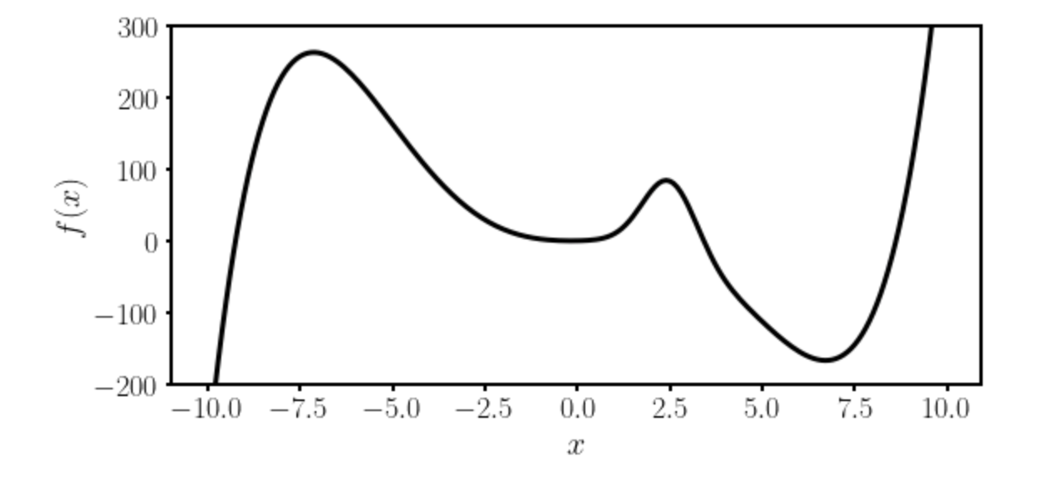
Gradient Descent I
Local minimum
Absolute minimum
Let’s suppose we want to find the absolute minimum of a given function $f(x)$.

Slide 39
Gradient Descent II
There is no analytical solution to the position of the absolute minimum for a network function.
Thus numerical methods are required.

Slide 40

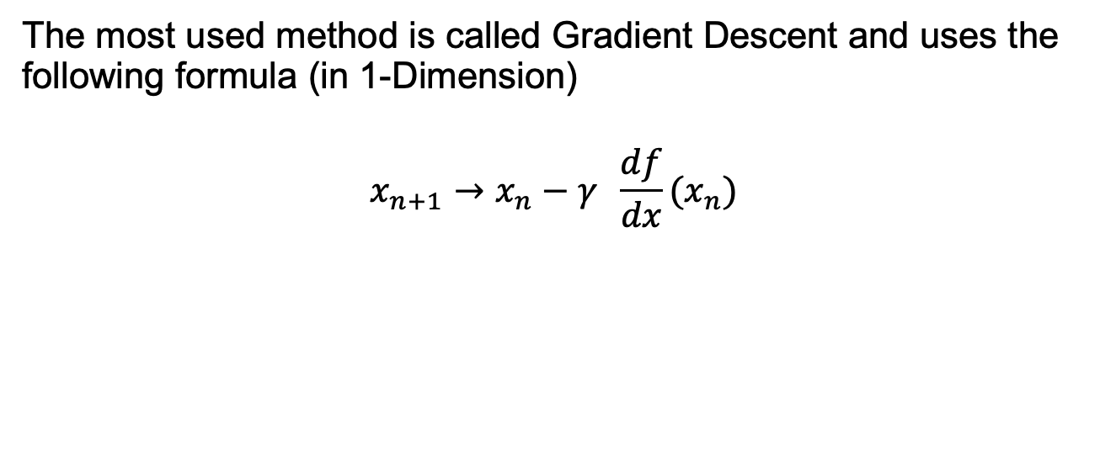
Gradient Descent III
The most used method is called Gradient Descent and uses the following formula (in 1-Dimension)
$$x_{n+1}→x_{n}−γ \frac{df}{dx}(x_{n})$$
Slope of the
function to be
minimized
New minimum location
approximation
Previous minimum location
approximation
Learning rate
The starting point $x_{0}$ is crucial.
Which one should we choose? Does it make a difference?

Slide 41

Gradient Descent IV
Update slow (slope is near zero)
Very fast update
Slope of the
function to be
minimized
$$x_{n+1}→x_{n}−γ \frac{df}{dx}(x_{n})$$

Slide 42
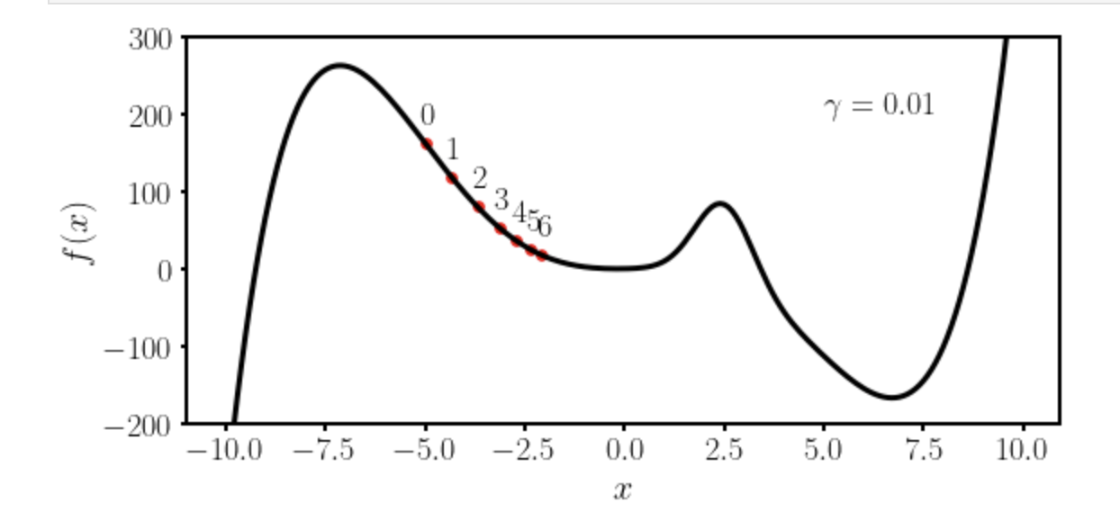
Gradient Descent V
Let’s suppose we want to find the absolute minimum of a given function $f(x)$.
We choose $x_{0}=−5$ and $γ=0.01$

Slide 43
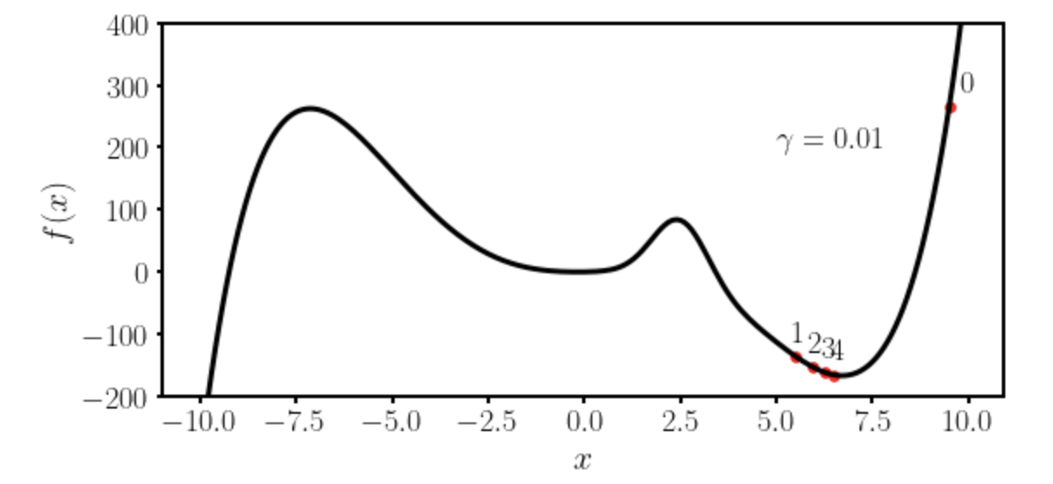
Gradient Descent VI
Let’s suppose we want to find the absolute minimum of a given function $f(x)$.
We choose $x_{0}=−9.5$ and $γ=0.01$

Slide 44
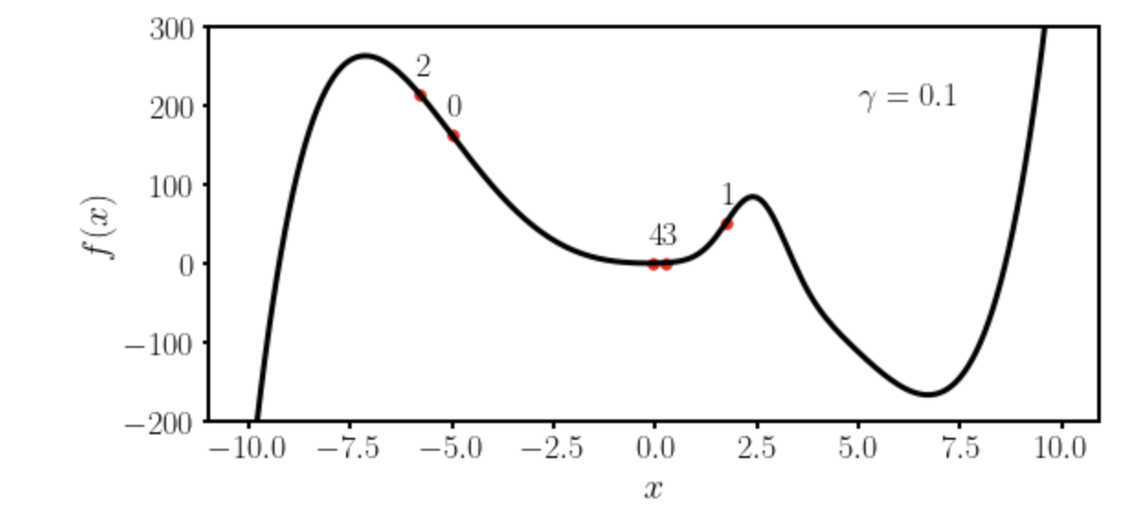
Gradient Descent VII
Let’s suppose we want to find the absolute minimum of a given function $f(x)$.
We choose $x_{0}=−5$ and $γ=0.1$

Slide 45
Some remarks about gradient descent
To use gradient descent you will need the derivative (or gradient in multiple dimensions) of the function you want to minimize.
Due to this reason methods as autodifferentiations and back-propagations have been developed to be able to calculate the derivative of a generic network function.
→ Gradient descent is not the most efficient way of finding minima. It gets easily stuck in local minima. More advanced optimisers have been developed and are typically used (see Adam).

Slide 46

How to check learning
The most fundamental way of checking learning is to plot the loss function vs. the number of iterations. Always do that!

Slide 47
First challenge: the right learning rate
https://www.benfrederickson.com/numerical-optimization/

Slide 48

Gradient Descent in many dimensions
For those of you with more mathematical and programming background here is an implementation from scratch of the gradient descent: http://adl.toelt.ai/gradientDescent/Gradient_descent_developed_from_scratch.html

Slide 49
Optimizers
Gradient Descent
RMSProp
Adam
And many others…

Slide 50

Comparison of algorithms in 2D
U. Michelucci, Applied Deep Learning with TensorFlow 2, Springer Nature, 2022

Slide 51

Comparison of algorithms in 2D
U. Michelucci, Applied Deep Learning with TensorFlow 2, Springer Nature, 2022

Slide 52

Comparison of algorithms in 2D
U. Michelucci, Applied Deep Learning with TensorFlow 2, Springer Nature, 2022

Slide 53

Comparison of algorithms in 2D
Source:Umberto Michelucci, Applied Deep Learning - A Case-Based Approach to Understanding Deep Neural Networks, APRESS 2018

Slide 54
Challenges with Neural Networks

Slide 55
Additional difficulties
Regularisation – How to avoid overfitting and make the models generalize better
Hyperparameter tuning - finding the best parameters to obtain the best values for the chosen metric
Metric analysis - detecting possible issues with the datasets
Training speed - optimizing to get the fastest training possible
Big datasets - working with amount of data that does not fit in memory anymore

Slide 56
Additional architectures
There are many architectures that are know to work best with different data types:
Convolutional neural networks: for multi-dimensional data types (as images)
Recurrent neural networks: time series, language, etc.
Many others have been developed to solve specific problem as: object localisation, segmentation (in MRI for example), etc.

Slide 57
Hands-on Session
https://playground.tensorflow.org

Slide 58
From here the only limit is your creativity!

